Slide 1
SG2000 PCB Layout Guide
Version: 0.2
Release date: 2022/09/13

Slide 2
Outline
Checklist
Stackup
DDR 电源绕线
Serdes讯号绕线 - MIPI/USB/EPHY
Single-end讯号绕线 - GPIO/SDIO - EMMC/AUD/XTAL/WIFI
模拟/数字电源绕线 - VDDC -模拟IO电源

Slide 3
SG2000 PCB Type
根据支持的不同 PKG 型式，PCB 可分为以下几种 PCB layout：: (1) QFN PKG: SG2002, DDR3/DDR2 SIP on PKG (4-Layer/6-Layer PCB) (2) BGA PKG: SG2000, DDR2/DDR3 SIP on PKG (4-Layer/6-Layer PCB)
Layout rule 分成以下两部分: (1) DDR Layout rule (2 types) (2) Serdes/Single-end/Power Layout rule (common rule)
与 PKG 型式和叠构相对应的 PCB layout rule 如下:
Type | Stackup | DDR layout rule | Serdes/Single-end/Power Layout rule
QFN PKG | (1) 4-layer PCB (2) 6-layer PCB (真6层) | QFN 电源绕线 | 4-layer/6-layer (真6层) PCB layout rule (common rule)
BGA PKG | (1) 4-layer PCB (2) 6-layer PCB (真6层) | BGA 电源绕线

Slide 4
Checklist

Slide 5
Checklist – Stackup – 4L-PCB/6L-PCB
No. | Rule | Description | Requirement | Check
1 | 4L-PCB 叠构要求 | 介电层/铜 厚度限制 | 1. 确认介电层厚度 – pp/core (1) pp<=5mils (Cu与pp 压合后, pp不含Cu的厚度) (2) L2/L3 Core 厚度>=25mils 2. 每层Cu厚度1oz.
2 | 6L-PCB 叠构要求 | 介电层/铜 厚度限制 | 1. 确认介电层厚度 – pp/core (1) L1/L2, L3/L4, L5/L6: pp<=5mils (Cu与pp 压合后, pp不含Cu的厚度) (2) all core 厚度>11mils 2. 每层Cu厚度1oz.

Slide 6
Checklist - Layout rule
No. | Rule | Description | Requirement | Check
1 | DDR routing | DDR3Q_1.5V rule | 1. 确认QFN PKG E-pad solder mask 覆盖区 (7.6x7.6mm2) 3 颗VIA 2. 建议将 DDR 布线/VIA/Cap 布局粘贴到 SOC PKG 下方
2 | MIPI routing | 表层/内层 阻抗控制 | 与PCB vendor 确认polar 结果: (1) 表层: Diff Coated Coplanar Strips with GND 1B (2) 内层: Diff Offset Coplanar Strips 1B1A
3 |  | 表层走线 lane to lane NO GND shielding | Lane to lane NO GND shielding 走线长度<3.5mm
4 |  | BGA PKG, GND plane rule – 确保MIPI 讯号return path | TX/RX在SOC ball下方GND plane预留3通道以上
5 |  | Length matching rule | 确认TX/RX length matching
6 | USB | 表层/内层 阻抗控制 | 与PCB vendor 确认polar 结果: (1) 表层: Diff Coated Coplanar Strips with GND 1B (2) 内层: Diff Offset Coplanar Strips 1B1A
7 |  | Length matching rule | P/N length matching
8 | EPHY routing | 表层/内层 阻抗控制 | 与PCB vendor 确认polar 结果: (1) 表层: Diff Coated Coplanar Strips with GND 1B (2) 内层: Diff Offset Coplanar Strips 1B1A
9 |  | Length matching rule | P/N length matching

Slide 7
Checklist - Layout rule
No. | Rule | Description | Requirement | Check
10 | Single-end rule | 表层/内层 shielding rule | Shielding rule
11 | EMMC rule | 表层/内层 shielding rule | Shielding rule
12 | AUD rule | 表层 shielding rule | Shielding rule
13 | XTAL rule | 表层 shielding rule | Shielding rule
14 | RTC rule | 表层 shielding rule | Shielding rule
15 | WIFI_ANT rule | 表层阻抗控制 | 与PCB vendor 确认polar 结果: (1) 表层: Coated Coplanar Strips with GND 1B
16 | VDC rule | 1. 确认Cap数量与位置, VIA数量 2. 通道宽度 | 1. Rule1: (1) SOC/PMIC 处VIA 数量 (2) SOC处Cap pin VDDC/GND VIA rule 2. 通道宽度参照 rule2 3. 建议将 VDDC 走线/VIA/Cap 布局粘贴到 SOC PKG 下方
17 | Analog IO Power rule | 1. 线宽rule 2. 确认Cap数量与位置, VIA数量 | 1. Rule1: (1) SOC/PMIC 处VIA 数量 (2) SOC处Cap pin power/GND VIA rule 2. 通道宽度参照 rule2 3.建议在 SOC PKG 下 附上 power trace/VIA/Cap layout=

Slide 8
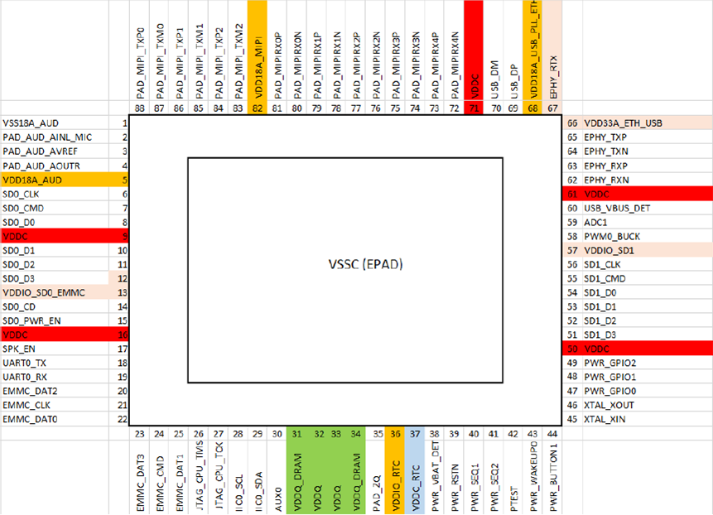
QFN Ball Map
MIPI
USB
EPHY
AUD
SDIO
SDIO
EMMC
DDR

Slide 9
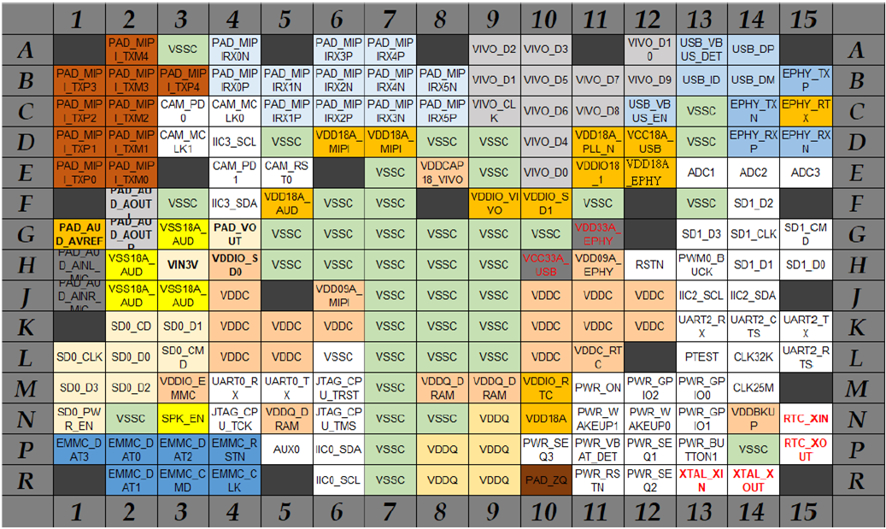
BGA Ball Map
MIPI
USB
EPHY
AUD
SDIO
SDIO
EMMC
DDR

Slide 10
Stackup
QFN/BGA PKG: SG200X
4-layer/6-layer PCB

Slide 11
PCB 4-Layer Stackup
叠构层数: 4层
叠构厚度: 1mm +/-10% <=厚度 <=1.6mm +/-10%
每层Cu采用1oz.
介电层厚度限制:
参考叠构
层号 | 材质 | 厚度限制
L1/L2 | Prepreg | <=5mils (Cu与pp 压合后, pp不含Cu厚度)
L3/L4
L2/L3 | Core | >=25mils

Slide 12
PCB 6-Layer Stackup
叠构层数: 6层
叠构厚度: 1.2mm +/-10% <= 厚度 <=1.6mm +/-10%
每层Cu采用1oz.
介电层厚度限制:
参考叠构
层号 | 材质 | 厚度限制
L1/L2 | Prepreg | <=5mils (Cu与pp 压合后, pp不含cu厚度)
L5/L6
L3/L4
L2/L3 | Core | >=11mils
L4/L5

Slide 13
DDR 电源绕线 (DDR3_1.5V)
QFN PKG: SG2002
4-layer/6-layer PCB

Slide 14
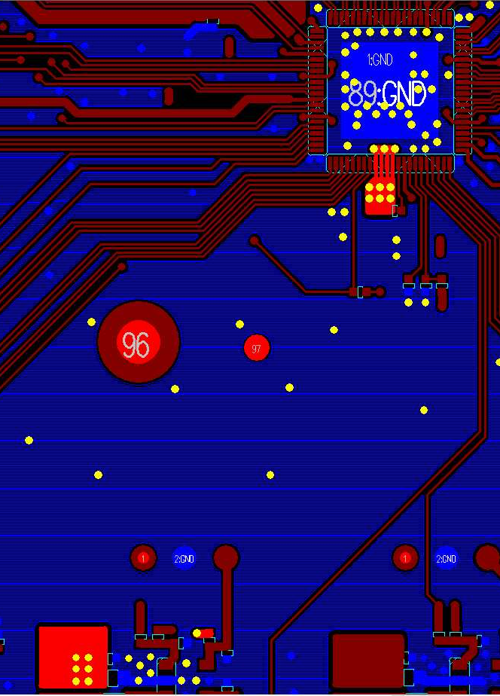
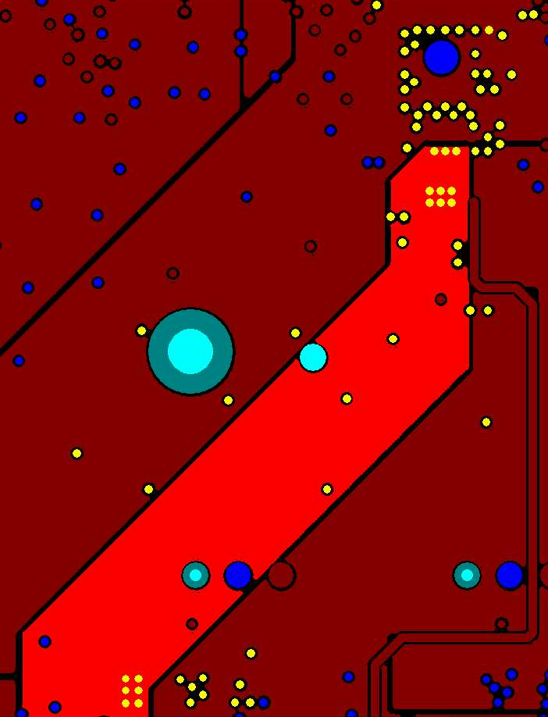
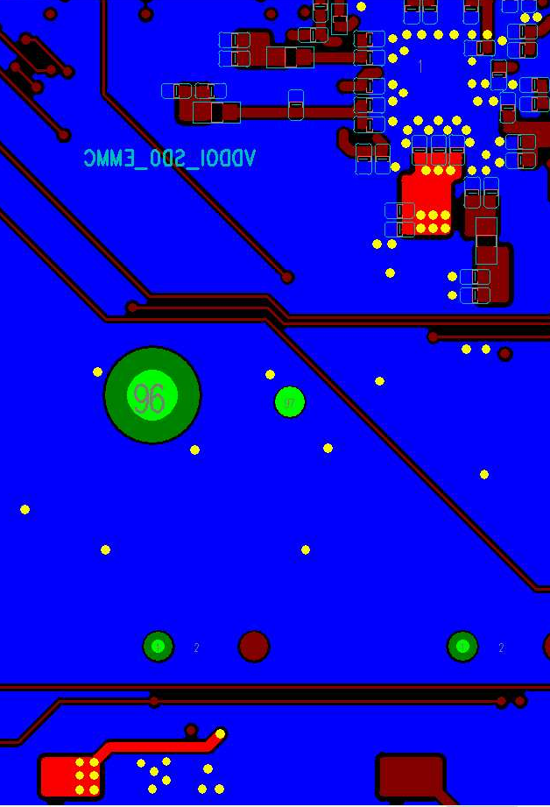
QFN - 4L/6L-PCB DDR Layout
Stackup: (1) 4L-PCB: GND@L1/L2/L4 (plane), 6L-PCB: GND@L1/L2/L3/L4/L6 (plane) (2) 4L-PCB: DDR3_1.5V@L3 (shape), 6L-PCB: DDR3_1.5V@L4 (shape)
4-Layers Stackup
L1 GND
4L-PCB: DDR3_1.5V@L3
6L-PCB: DDR3_1.5V@L4
pp
DDR3_1.5V@Top
DDR3_1.5V@Bottom
L2 : GND
SOC
Core
pp
L3 : DDR3_1.5V
L4 : GND
6-layers Stackup
L1 GND
pp
L2 : GND
Core
L3 : GND
pp
L4 : DDR3_1.5V
Core
PMIC
pp
L5 : GND
L6 : GND

Slide 15
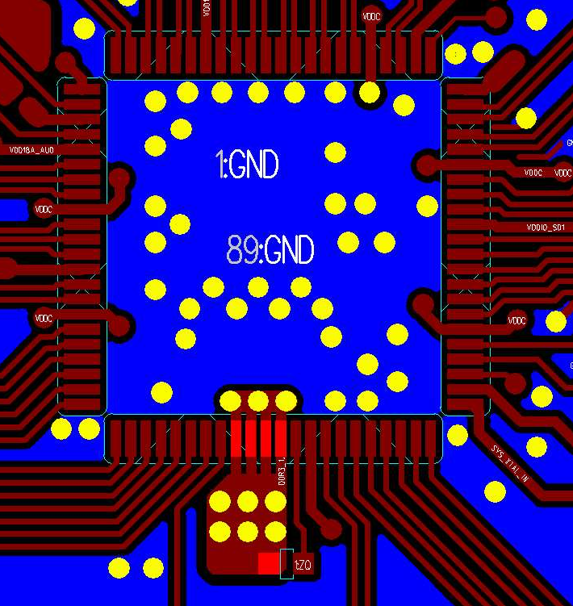
QFN - 4L/6L-PCB - DDR3_1.5V - Rule 1
Power | Layer | SOC VIA count | Layout rule
DDR3_1.5V | Top | (1) @E-pad 7.6x7.6mm2区域: VIA 数量: 3 (2) pin out区域: VIA 数量: 6 | (1) 覆盖Solder mask区域: E-pad 7.6x7.6mm² (2) 非覆盖Solder mask区域: E-pad 6x6mm² (3) 确认DDR3_1.5V SOC 端VIA数量
DDR3_1.5V@Top
E-pad aera 7.6x7.6mm2 (solder mask)
SOC
E-pad aera 6x6mm2 (uncover solder mask)
pin out区域

Slide 16
QFN - 4L/6L-PCB – DDR3_1.5V - Rule 2
Power | Layer | Layout rule
DDR3_1.5V | 4L-PCB: DDR3_1.5V@L3 6L-PCB: DDR3_1.5V@L4 | DDR3_1.5V main route, (1) 确认SOC与PMIC处有下各6颗VIA (2) 扣除破孔有效宽度: W1>=1.5mm, W2>=1.5mm
4L-PCB: DDR3_1.5V@L3
6L-PCB: DDR3_1.5V@L4
DDR3_1.5V@Top
SOC
SOC区域VIA
W2
W1
PMIC
PMIC区域 VIA

Slide 17
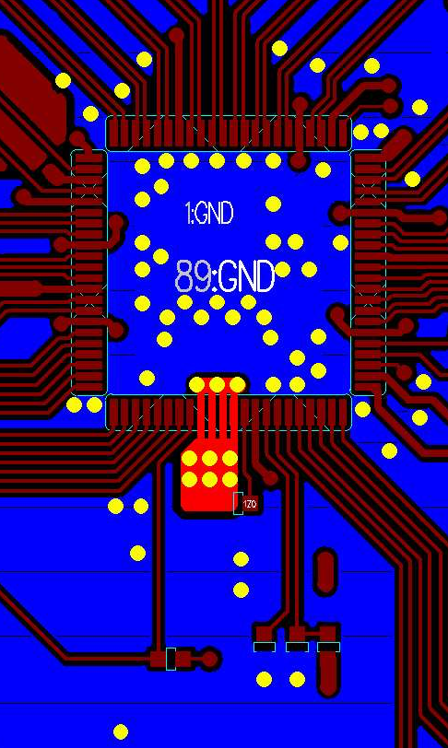
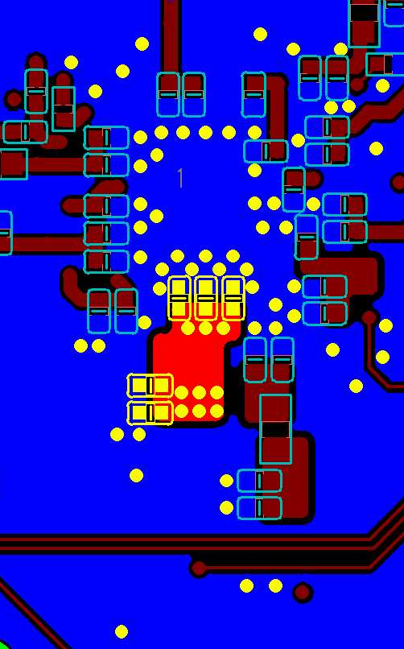
QFN - 4L/6L-PCB - DDR3Q_1.5V - Rule 3
Power | Layer | DeCap@Dram area | Layout rule
DDR3Q_1.5V | Top/Bottom | DDR3Q_1.5V@Bottom: (1) 0402 0.1uF: C1/C2 (2) 0402 1uF: C3/C4 (3) 0402 4.7uF: C1 | (1) DDR3_1.5V VIA rule E-pad 区域 3 颗via紧连C1/C2/C3 Pin-out 区域 6颗 via紧连C4/C5 (1) GND VIA rule 确认每颗Cap旁至少1颗GND VIA
DDR3_1.5V@Top
DDR3_1.5V@Bottom
C1
C2
C3
E-pad 区域:3 VIAs
C4
Pin-out 区域:6 VIAs
C5

Slide 18
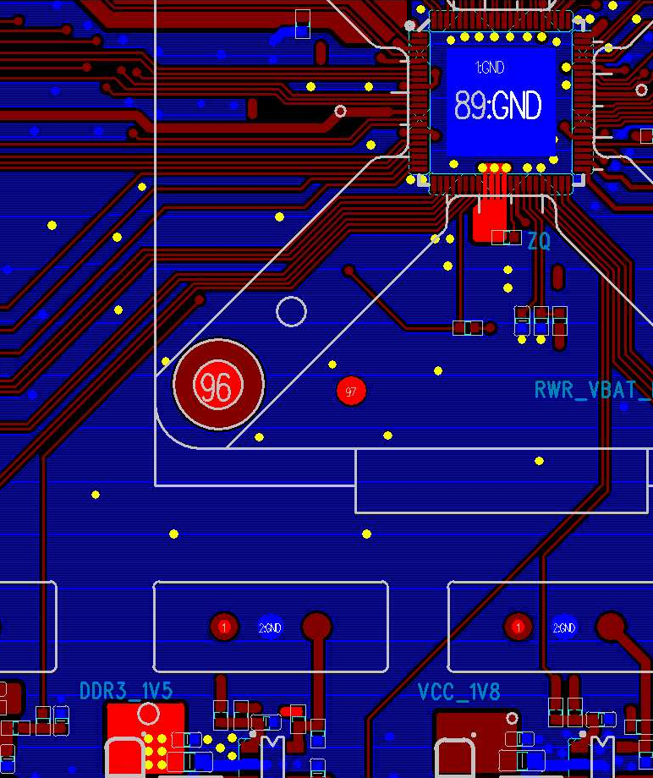
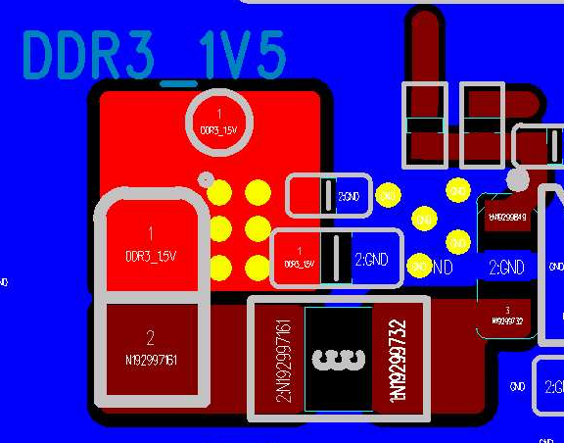
QFN - 4L/6L-PCB - DDR3_1.5V - Rule 4
Power | PMIC 分支点 VIA 数量
DDR3_1.5V | (1) DDR3_1.5V: VIA 数量>=6 (2) GND: VIA 数量>=5
DDR3_1.5V@Top
PMIC routing area
PMIC 分支点 VIA 数量
DDR3_1.5V:
VIA 数量6
GND:
VIA 数量5
PMIC

Slide 19
DDR 电源绕线 (DDR3_1.5V)
BGA PKG: SG2000
4-layer/6-layer PCB

Slide 20
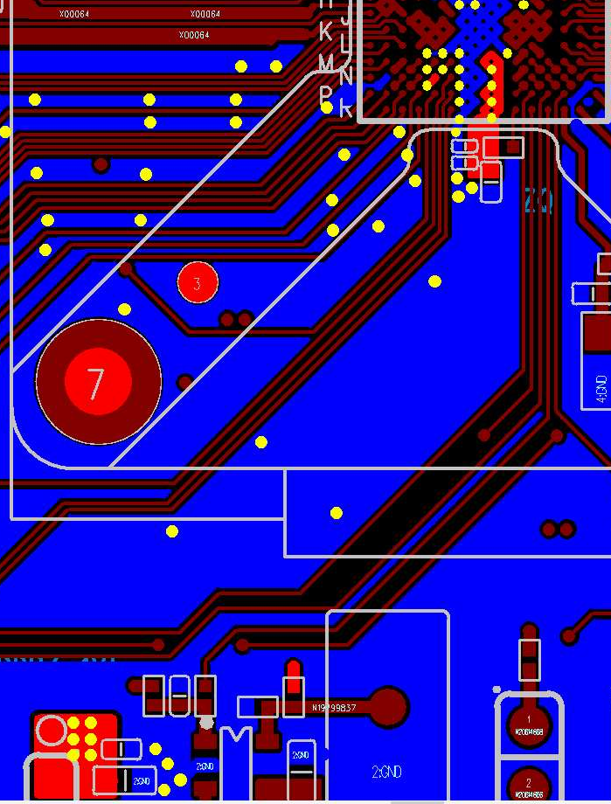

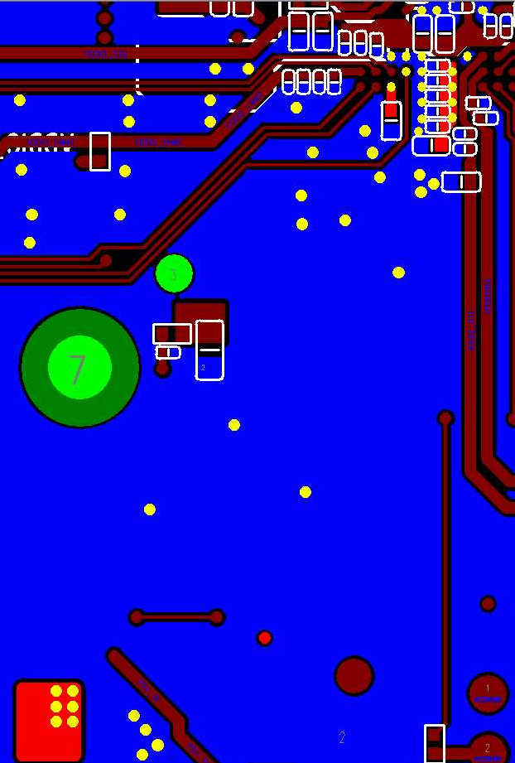
BGA – 4L/6L-PCB DDR Layout
Stackup: (1) 4L-PCB: GND@L1/L2/L4 (plane), 6L-PCB: GND@L1/L2/L3/L4/L6 (plane) (2) 4L-PCB: DDR3_1.5V@L3 (shape), 6L-PCB: DDR3_1.5V@L4 (shape)
4-Layers Stackup
L1 GND
4L-PCB: DDR3_1.5V@L3
6L-PCB: DDR3_1.5V@L4
pp
DDR3_1.5V@Top
DDR3_1.5V@Bottom
L2 : GND
SOC
Core
pp
L3 : DDR3_1.5V
L4 : GND
6-layers Stackup
L1 GND
pp
L2 : GND
Core
L3 : GND
pp
L4 : DDR3_1.5V
Core
PMIC
pp
L5 : GND
L6 : GND

Slide 21
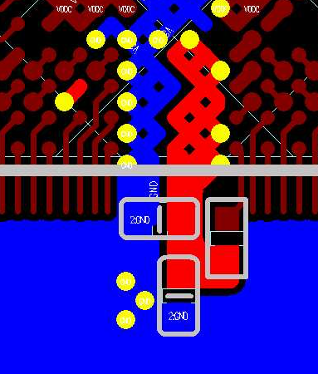
BGA – 4L/6L-PCB - DDR3_1.5V - Rule 1
Power | Layer | SOC VIA count | Layout rule
DDR3_1.5V | Top | (1) DDR3_1.5V (ball N5): 1 (2) DDR3_1.5V (merge ball): 4 | (1) 确认DDR3_1.5V SOC 端VIA数量 (2) Ball N5 VIA: 连接bottom Cap (3) Merge ball VIA: 连接内层main route trace
DDR3_1.5V@Top
DDR3_1.5V (merge ball)
DDR3_1.5V (ball N5)

Slide 22
BGA – 4L/6L-PCB - DDR3_1.5V - Rule 2
Power | Layer | Layout rule
DDR3_1.5V | 4L-PCB: DDR3_1.5V@L3 6L-PCB: DDR3_1.5V@L4 | DDR3_1.5V main route: (1) 确认SOC处有4颗VIA, PMIC处有大于等于5颗VIA (2) 扣除破孔有效宽度: W1>=1.5mm, W2>=1.5mm
4L-PCB: DDR3_1.5V@L3
6L-PCB: DDR3_1.5V@L4
DDR3_1.5V@Top
SOC
SOC
SOC区域VIA
W2
W1
PMIC
PMIC区域 VIA

Slide 23
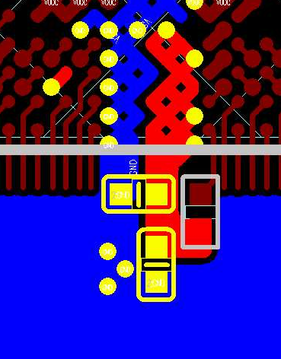
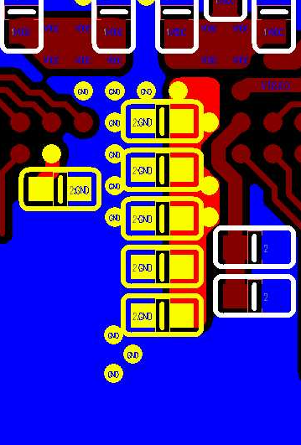
BGA – 4L/6L-PCB - DDR3Q_1.5V - Rule 3
Power | Layer | DeCap@Dram area | Layout rule
DDR3Q_1.5V | Top/Bottom | DDR3Q_1.5V@Top: (1) 0402 1uF: C1/C2 DDR3Q_1.5V@Bottom: (1) 0402 0.1uF: C4/C5 (2) 0402 1uF: C3/C7/C6 (3) 0402 4.7uF: C8 | (1) DDR3_1.5V VIA rule 确认每颗Cap旁至少1颗DDR3_1.5V VIA (2) GND VIA rule 确认每颗Cap旁至少1颗GND VIA
DDR3_1.5V@Top
DDR3_1.5V@Bottom
DDR3_1.5V (ball N5)
DDR3_1.5V (merge ball)
C4
C5
C3
C6
C1
C7
C2
C8

Slide 24
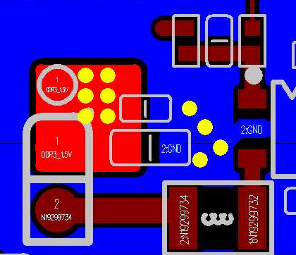

BGA – 4L/6L-PCB - DDR3_1.5V - Rule 4
Power | PMIC 分支点 VIA 数量
DDR3_1.5V | (1) DDR3_1.5V: VIA 数量>=6 (2) GND: VIA 数量>=5
DDR3_1.5V@Top
PMIC routing area
PMIC 分支点 VIA 数量
DDR3_1.5V:
VIA 数量6
GND:
VIA 数量5
PMIC

Slide 25
Serdes 讯号绕线
QFN/BGA PKG: SG200X
4-layer/6-layer PCB

Slide 26
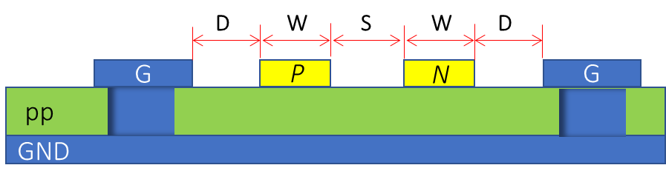
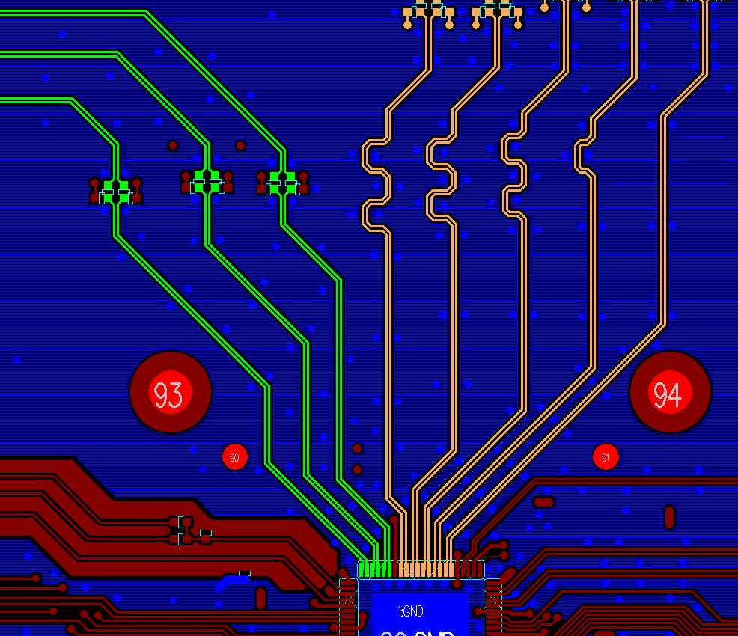
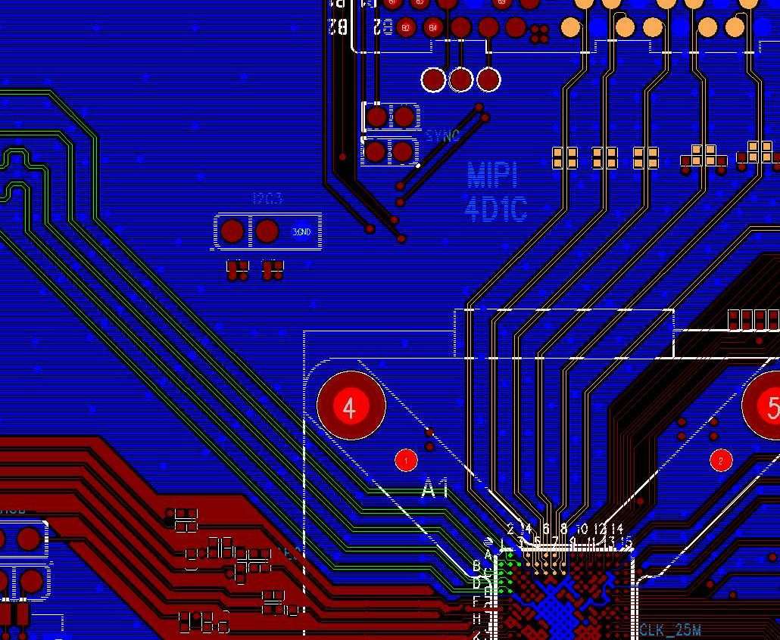
QFN/BGA – 4L/6L-PCB- MIPI Routing – 表层走线 Option1 Rule 1
MIPI TX/RX
Signal | Layer | Zo | Trace width/spacing (mm) | Shielding Rule
MIPI_TX/RX Diff pair | Top/ Bottom | 100 ohm | 0.125/0.125/0.15 (W/S/D) | Lane to Lane GND shielding
QFN MIPI TX/RX differential signals layout@Top
BGA MIPI TX/RX differential signals layout@Top
MIPI_TX
MIPI_RX
MIPI_TX
MIPI_RX
SOC
SOC

Slide 27
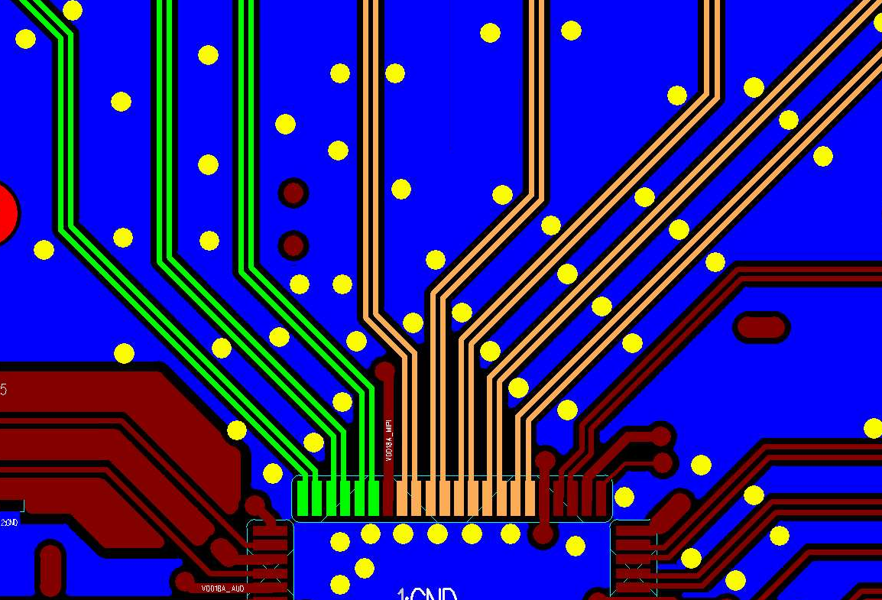
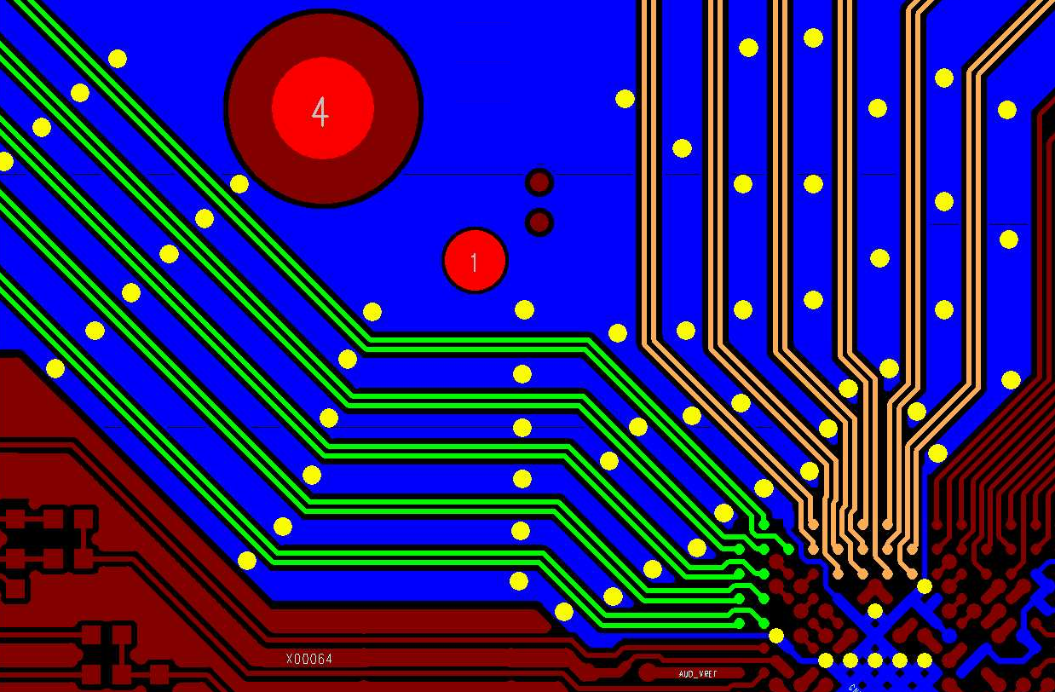
QFN/BGA – 4L/6L-PCB – MIPI Routing – 表层走线 Option1 - Rule 2
Signal | Layer | Requirement | Layout Rule
MIPI_TX/RX Diff pair | Top/ Bottom | Lane to lane shielding GND VIA distance | L1 (GND stitching VIA) < 7.5mm NO GND shielding length L2 < 3.5mm
QFN MIPI TX/RX shielding GND VIA distance@Top
BGA MIPI TX/RX shielding GND VIA distance@Top
L1
L1
L2
L2
SOC
SOC

Slide 28
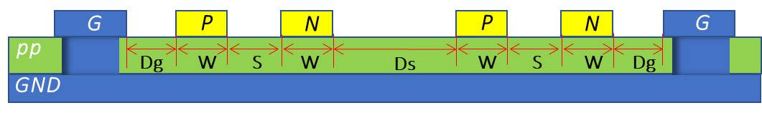
QFN/BGA – 4L/6L-PCB – MIPI Routing – 表层走线 Option2 - Rule
Signal | Layer | Zo | Trace width/spacing (mm) | Shielding Rule
MIPI_TX/RX Diff pair | Top/ Bottom | 100ohm | 0.125/0.125/0.3/0.3 (W/S/Ds/Dg) | (1) Lane to Lane NO GND shielding, 确认diff下方GND plane完整 (2) TX/RX Group GND shielding, GND shielding必须位于VIA下方: VIA to VIA 距离<7.5mm (3) Lane to lane 距离限制: 1) 绕线长度>=10mm, Ds=3W, Dg=3W (可允许Dg=2W) 2) 绕线长度<10mm, Ds>=2W, Dg>=2W
MIPI TX
MIPI RX

Slide 29
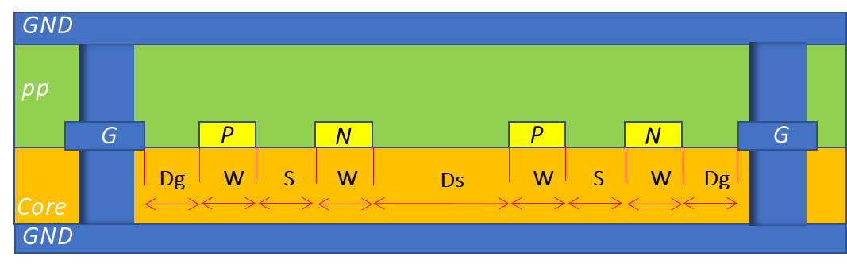
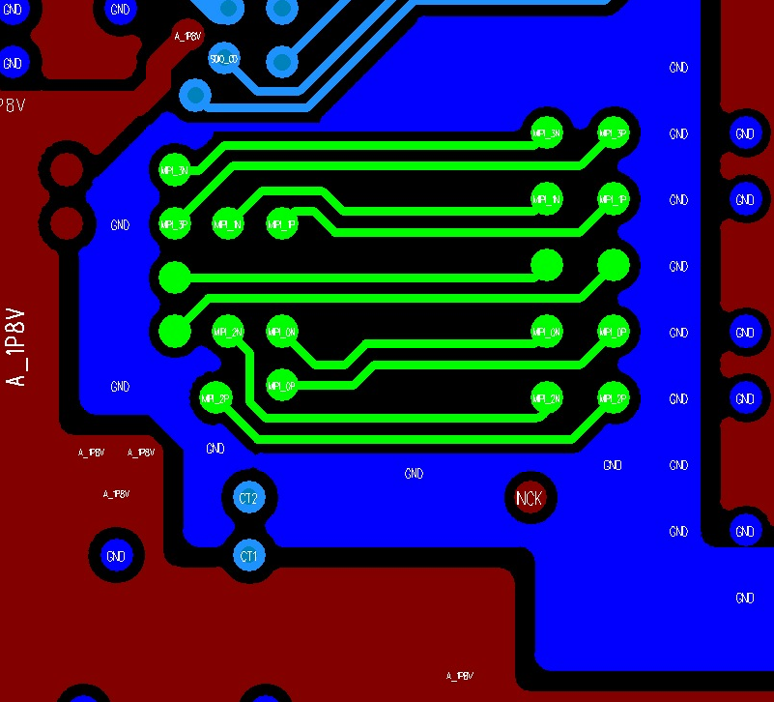
QFN/BGA – 4L/6L-PCB – MIPI Routing – 内层走线 - Rule
Signal | Layer | Zo (ohm) | Trace width/spacing (mm) (W/S/Ds/Dg) | Shielding Rule
MIPI_TX/RX Diff pair | 4L-PCB: L2 6L-PCB: L3 | 100 | 4L-PCB: 0.125/0.25/0.3/0.3 6L-PCB: 0.125/0.25/0.3/0.3 | (1) Lane to Lane NO GND shielding, 确认diff下方 GND plane完整 (2) TX/RX Group GND shielding, GND shielding 必须位于 VIA 下方: VIA to VIA 距离<7.5mm (3) Lane to lane 距离限制: 1) 绕线长度>=10mm, Ds=3W, Dg=3W (可允许Dg=2W) 2) 绕线长度<10mm, Ds>=2W, Dg>=2W
MIPI TX
RX@内层, Option2, RX group GND shielding
GND
SOC
MIPI_RX
MIPI RX
GND

Slide 30
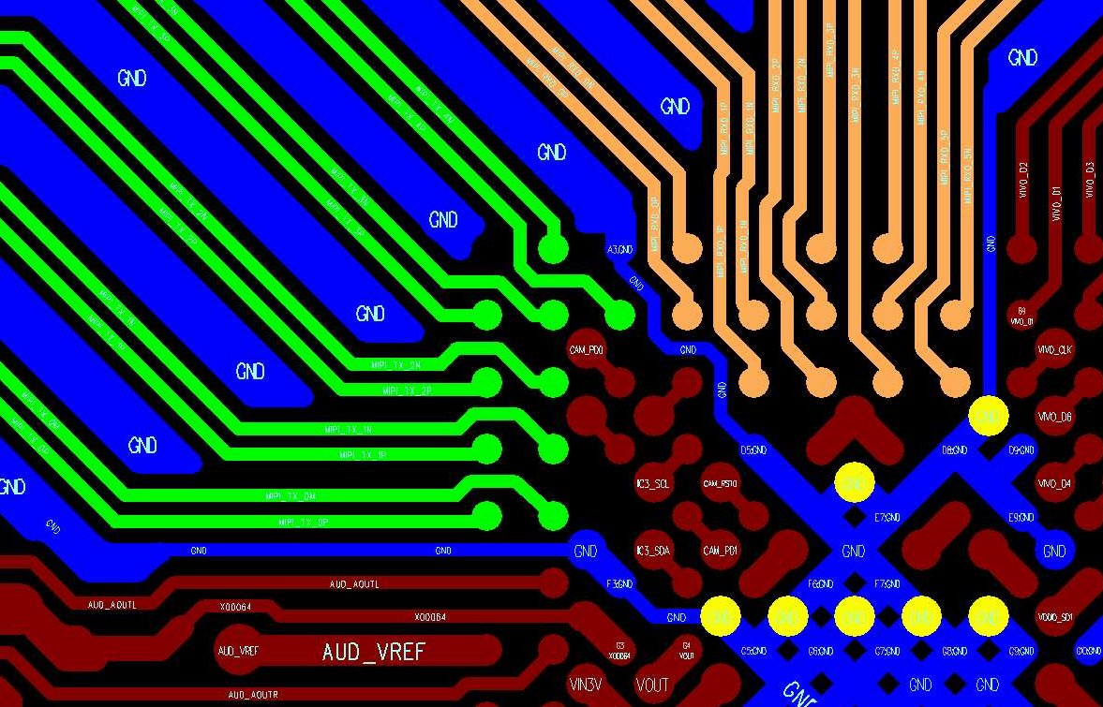
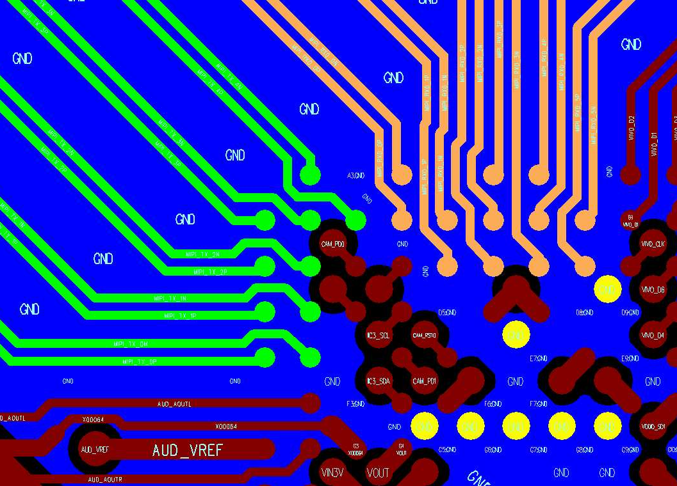
BGA – 4L/6L-PCB – MIPI Routing – GND Plane Rule
Signal | Layer | Layout rule
TX/RX GND plane | L2 | 确认TX/RX@SOC 下方GND plane@L2 的破孔会保留3组通道以上 (Layer2 GND plane 请参照下图)
MIPI TX/RX@Top
MIPI TX/RX@Top + GND plane@L2
DQ/CA@L1
GND plane 保留3个通道以上
MIPI_TX
MIPI_RX
3
2
SOC
1
GND VIA

Slide 31
MIPI Routing – Length Matching Rule
Signal | Matching Reference | Matching Length
TX | inter skew | <=2.5mm (100mils)
RX | inter skew
TX | P/N intra skew | <=0.5mm (20mils)
RX | P/N intra skew

Slide 32
QFN/BGA – 4L/6L-PCB – USB Routing – 表层走线- Rule
Signal | Layer | Zo | Trace width/spacing (mm) | Shielding Rule
USB Diff pair | Top/ Bottom | 90ohm | 0.125/0.1/0.15 (W/S/D) | Lane to lane GND shielding. Shielding GND VIA: Lane to Lane GND shielding必须在VIA下方 (VIA to VIA 距离<=7.5mm)
USB Diff pair
D
W
S
W
D
Shielding GND VIA
GND
G
P
N
G
S1
Diff P/N
pp
GND
GND

Slide 33
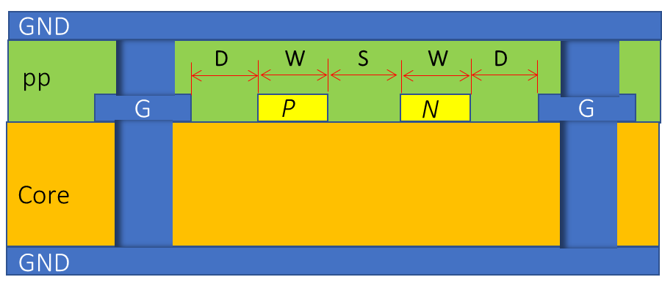
QFN/BGA – 4L/6L-PCB – USB Routing – 内层走线- Rule
Signal | Layer | Zo | Trace width/spacing (mm) | Shielding Rule
USB Diff pair | 4L-PCB: L2 6L-PCB: L3 | 90ohm | 4L-PCB: 0.125/0.175/0.15 (W/S/D) 6L-PCB: 0.125/0.175/0.15 (W/S/D) | Lane to lane GND shielding. Shielding GND VIA: Lane to Lane GND shielding必须在VIA下方 (VIA to VIA 距离 S1<=7.5mm)
USB Diff pair
Shielding GND VIA
GND
S1
Diff P/N
GND

Slide 34
USB Routing – Length Matching Rule
Signal | Matching Reference | Matching Length
USB_DM USB_DP | P/N intra skew | <=0.5mm (20mils)

Slide 35
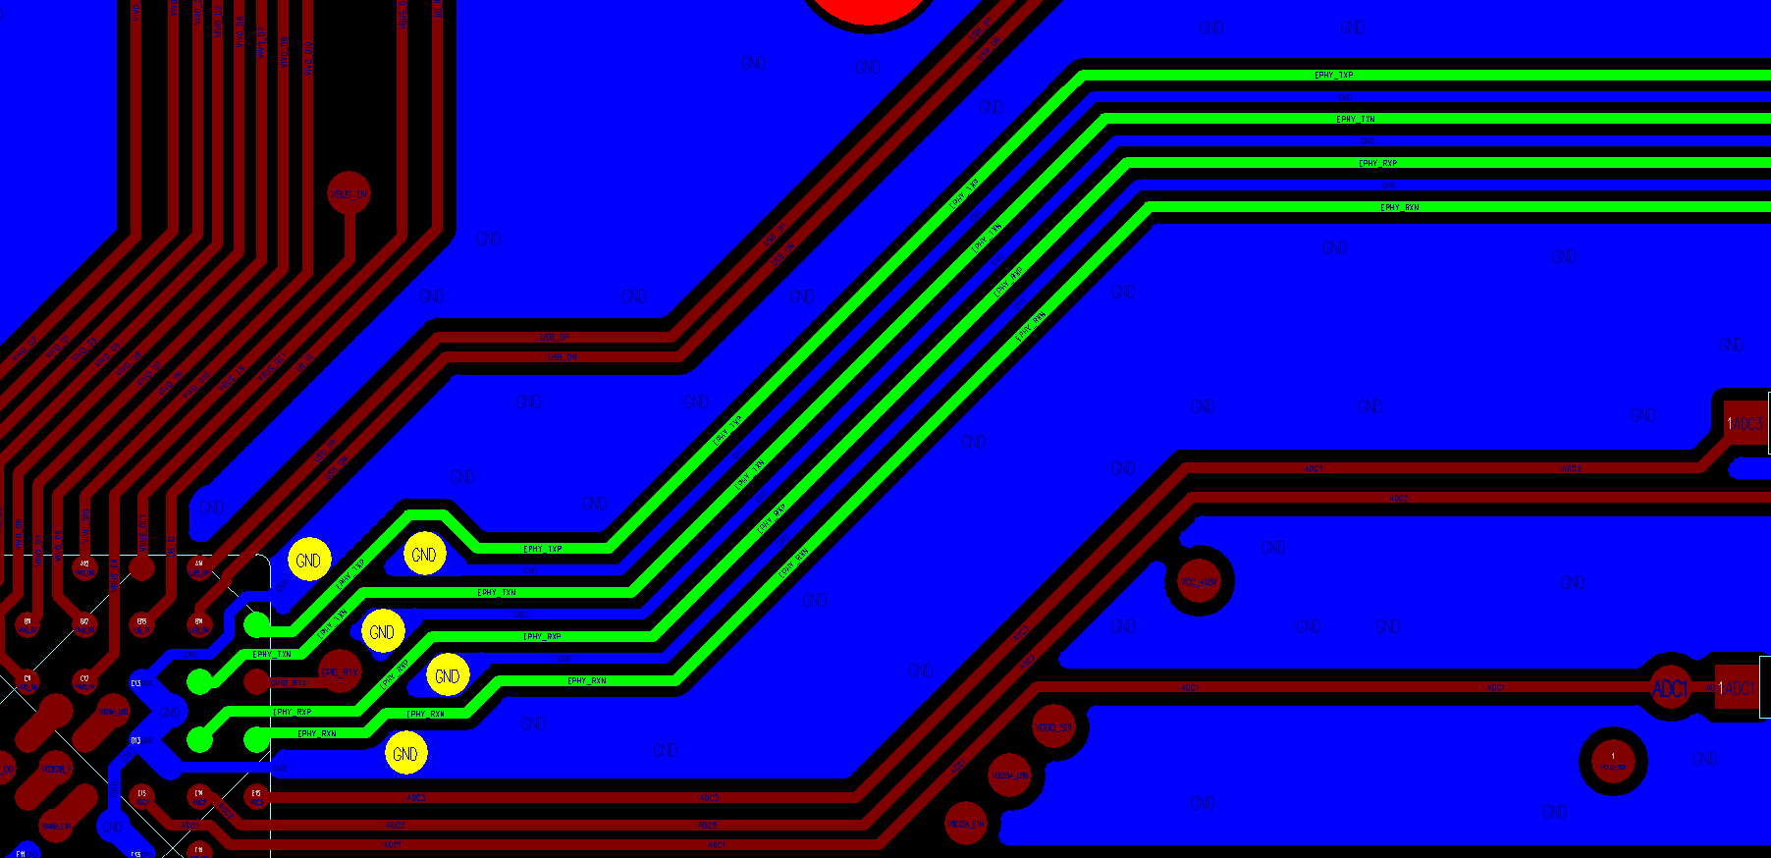
QFN/BGA – 4L/6L-PCB - EPHY Routing – 表层走线 - Rule1
Signal | Layer | Zo | Trace width/spacing (mm) | Shielding Rule
EPHY TX/RX Diff pair | Top | No control | 0.125/0.125/0.125 (Ws/Sg/Wg) | P/N 之间须有GND trace shielding TX/RX 之间须有GND trace shielding GND trace VIA rule: 1) 需确认靠近SOC端的GND trace 至少有一颗VIA与SOC PKG GND 构成回路 2) 需确认靠近transformer端的GND trace至少有一颗VIA与transformer GND pin构成回路
Shielding GND VIA
EPHY TX/RX
Wg
Sg
Ws
Sg
Wg
Sg
Ws
Sg
Wg
G
P
G
N
G
G
Core
SOC
GND
GND 回流VIA

Slide 36
QFN/BGA – 4L/6L-PCB - EPHY Routing – 表层走线 - Rule2
Signal | Layer | Requirement | Layout Rule
EPHY TX/RX | Top | TX to RX GND shielding 0.125/0.125 (Wg/Sg) | GND trace VIA rule: 1) 需确认靠近SOC端的GND trace 至少有一颗VIA与SOC PKG E-pad构成回路 2) 需确认靠近transformer端的GND trace至少有一颗VIA与transformer GND pin构成回路
EPHY TX/RX Isolation
TX
Sg
Wg
Sg
RX
G
P
G
N
G
P
G
N
G
Core
GND

Slide 37
EPHY Routing – Length Matching Rule
Signal | Matching Reference | Matching Length
EPHY TX/RX Diff pair | P/N intra skew | <=0.5mm (20mils)

Slide 38
Single-end 讯号绕线
QFN/BGA PKG: SG200X
4-layer/6-layer PCB

Slide 39
QFN/BGA – 4L/6L-PCB - Single-end – Rule
Signal | Layer | Shielding Rule | Trace width/Spacing (mm)
SDIO RTC | 4L-PCB: Top/Bottom/L3 6L-PCB: Top/Bottom/L3 | Break out (fan-out) region: NO GND trace shielding, ref GND plane | W>=0.1 0.1/0.1 (S/D) (0.1mm spacing)
 |  | Main rout: NO GND trace shielding, ref GND plane | W>=0.1 0.15/0.1 (S/D) (0.15mm spacing)
NO GND trace shielding
G
S
S
S
…
S
G
pp
D
W
S
W
S
W
W
D
GND

Slide 40
QFN/BGA - 4L/6L-PCB– EMMC – Rule
Signal | Layer | Shielding Rule | Trace width/spacing (mm)
EMMC D0~D3 | Top | Break out (fan-out) region: NO GND trace shielding, ref GND plane | (1) W>=0.1 (2) 0.1/0.1 (S/D) (0.1mm spacing)
 |  | Main rout: NO GND trace shielding, ref GND plane | W>=0.1 0.15/0.1 (S/D) (0.15mm spacing)
Signal | Layer | Shielding Rule | Trace width/spacing (mm)
EMMC_CLK EMMC_CMD EMMC_RST_N (BGA) | 4L-PCB: Top/Bottom/L3 6L-PCB: Top/Bottom/L3 | Break out (fan-out) region: NO GND trace shielding, ref GND plane | (1) W>=0.1 (2) 0.1/0.1 (S/D)
 |  | per trace shielding, ref GND plane | (1) W>=0.1 (2) D=0.1
NO GND trace shielding
…
Per trace shielding
G
S
S
S
S
G
G
S
G
pp
D
W
S
W
S
W
W
D
pp
D
W
D
GND
GND

Slide 41
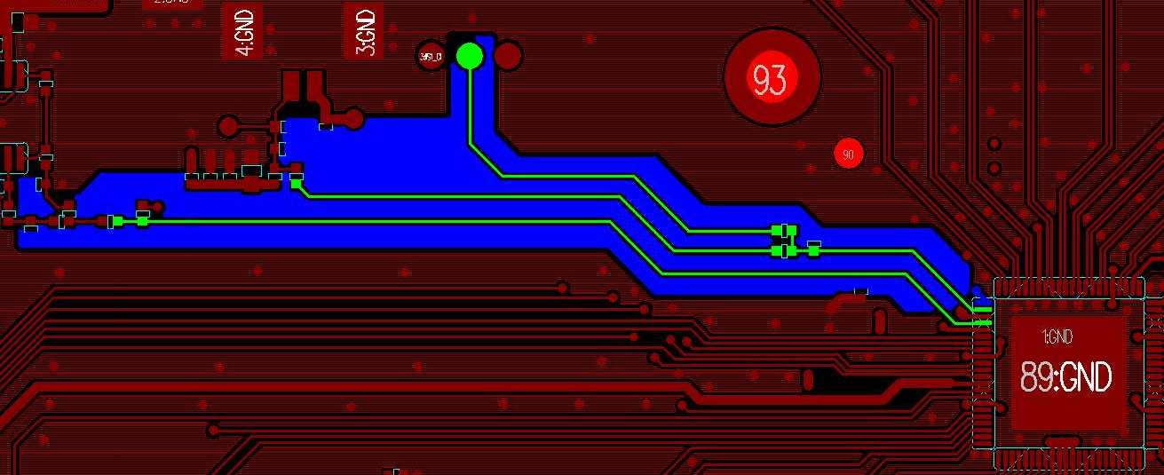
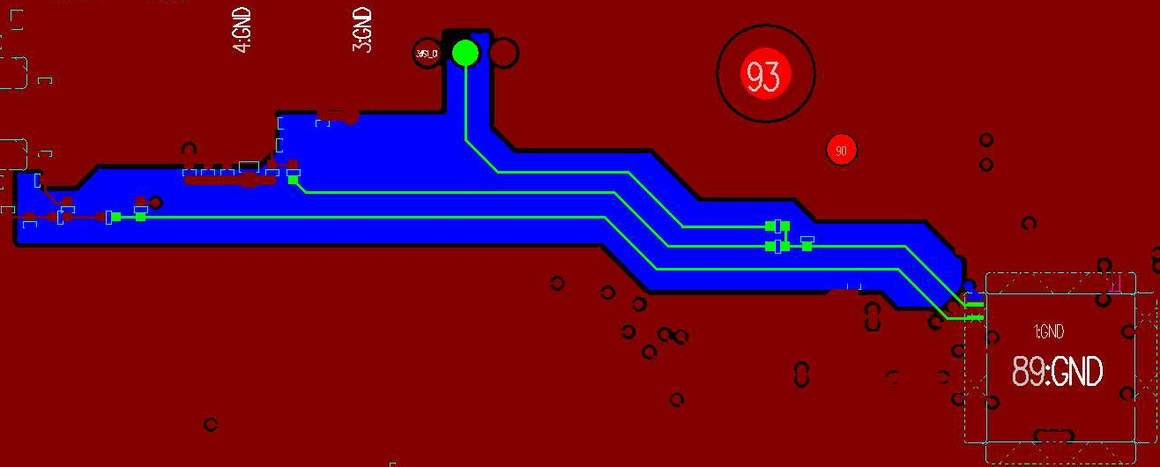
QFN 4L/6L-PCB – AUD – Rule
Signal | Layer | Shielding Rule | Trace width/Spacing (mm)
AUD_MIC_L AUD_MIC AUD_OUT | Top | (1) per trace shielding (2) ref AUD GND plane (3) 确认AUD 讯号线下方有 完整AUD GND plane | W>=0.1 D=0.1
Per trace shielding
G
S
G
pp
D
W
D
AUD GND
AUD@Top
AUD@L1/L2
AUD GND
AUD GND
AUD GND
pin

Slide 42
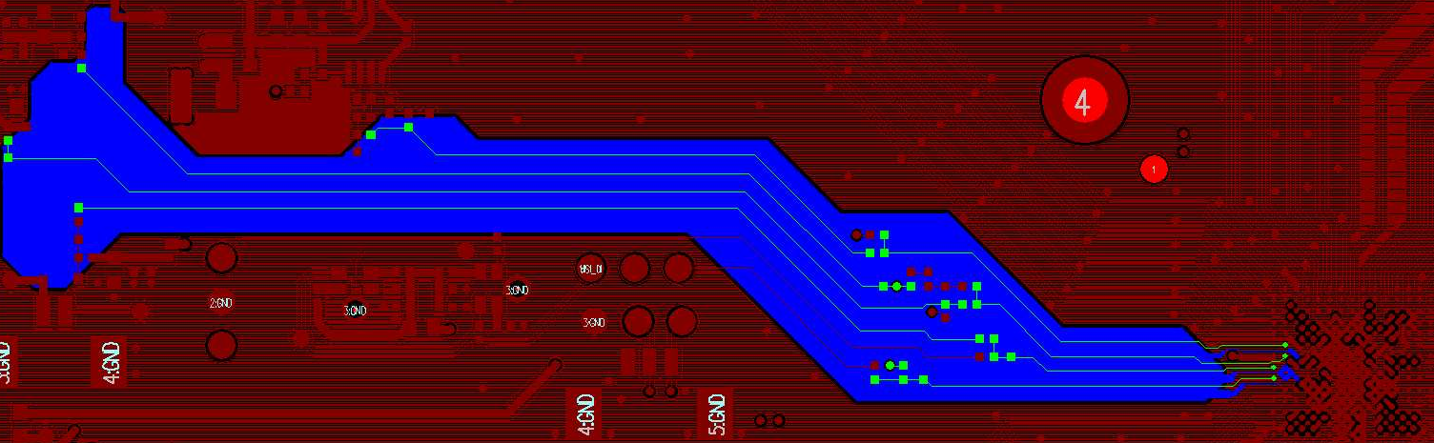
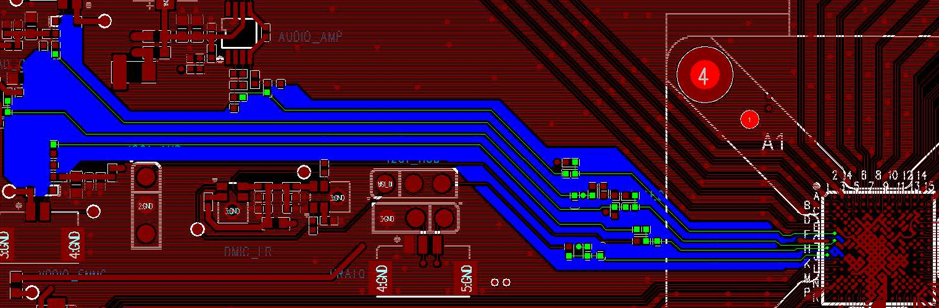
BGA – 4L/6L-PCB – AUD – Rule
Signal | Layer | Shielding Rule | Trace width/Spacing (mm)
AUD_MIC_L/AUD_MIC_R AUD_MICL/AUD_MICR AUD_AOUTL/AUD_AOUR AC_AOUTL/AC_AOUR | Top | (1) per trace shielding (2) ref AUD GND plane (3) 确认AUD 讯号线下方有完整AUD GND plane | W>=0.1 D=0.1
Per trace shielding
G
S
G
pp
D
W
D
AUD GND
AUD@Top
AUD@L1/L2
AUD GND
AUD GND
AUD GND ball

Slide 43
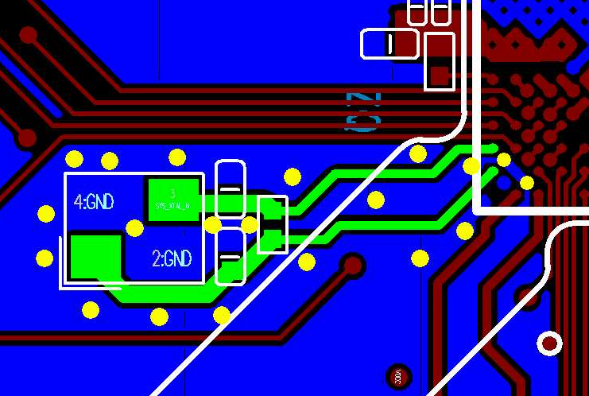
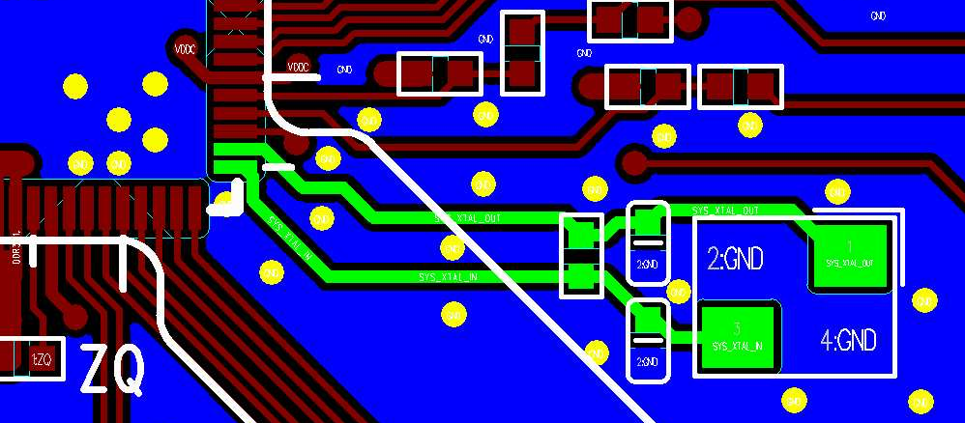
QFN/BGA – 4L/6L-PCB – XTAL_IN/OUT - Rule
Signal | Layer | Shielding Rule | Trace width/Spacing (mm)
SYS_XTAL_IN SYS_XTAL_OUT | Top | per trace shielding ref GND plane | 0.25/0.25 (W/D)
Per trace shielding
G
S
G
pp
D
W
D
GND
QFN XTAL@Top
BGA XTAL@Top
XTAL_IN
XTAL IC
XTAL_OUT

Slide 44
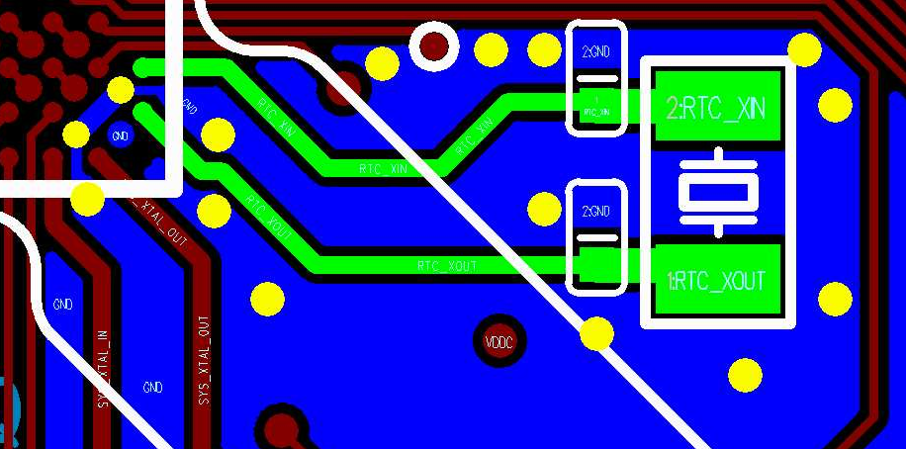
BGA only – 4L/6L-PCB – RTC_XIN/XOUT - Rule
Signal | Layer | Shielding Rule | Trace width/spacing (mm)
RTC_IN RTC_OUT | Top | 电容 to XTAL: per trace shielding | 0.25/0.1 (W/D)
XTAL@L1
SOC
XTAL
Per trace shielding
G
S
G
RTC_XIN
pp
D
W
D
GND
RTC_XOUT
Two trace shielding
G
S
S
G
pp
D
W
S
W
D
GND

Slide 45
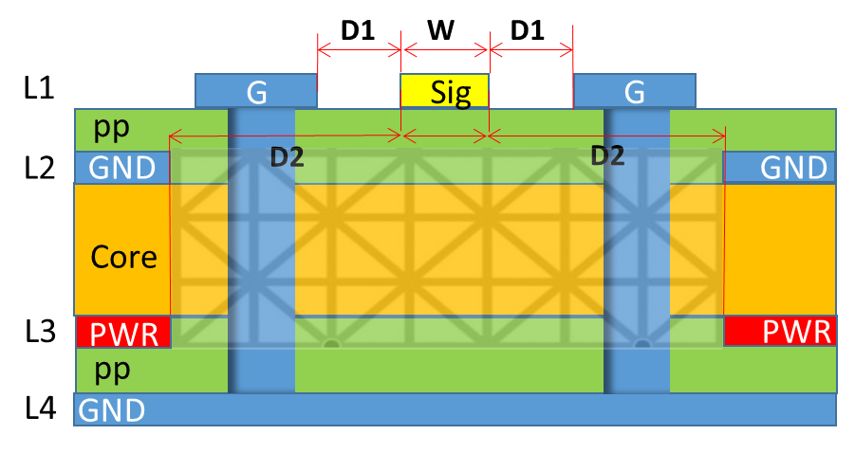
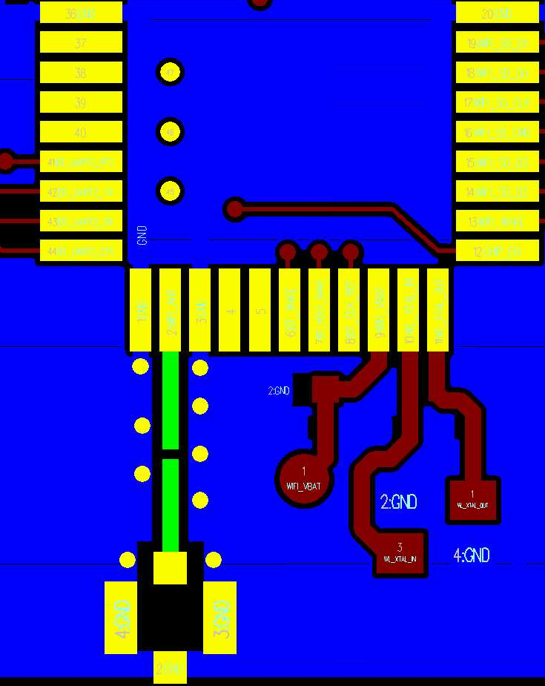
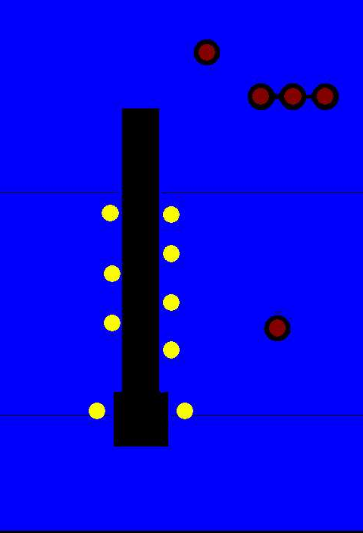
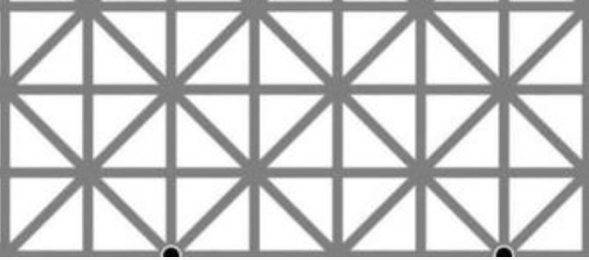
QFN/BGA – 4L/6L-PCB – WIFI_ANT Layout Rule
Signal | Layer | Zo | Shielding Rule | Trace width/spacing (mm)
WIFI_ANT | Top | 50ohm | Per trace shielding | 0.75/0.15/0.3 (W/D1/D2)
4L-PCB
WIFI_ANT@Top
WIFI_ANT@GND/PWR plane
WIFI_ANT 下方plane
需挖空
6L PCB
D1
W
D1
L1
G
Sig
G
pp
D2
D2
L2
GND
GND
WIFI_ANT
Core
L3
GND
GND
pp
PWR
PWR
L4
GND
Core
L5
GND

Slide 46
模拟/数字电源绕线
QFN PKG: SG2002
4-layer/6-layer PCB

Slide 47
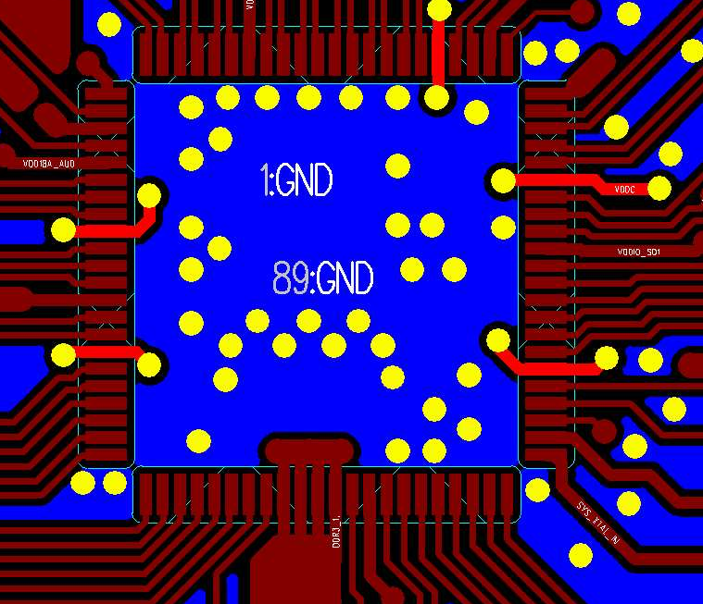
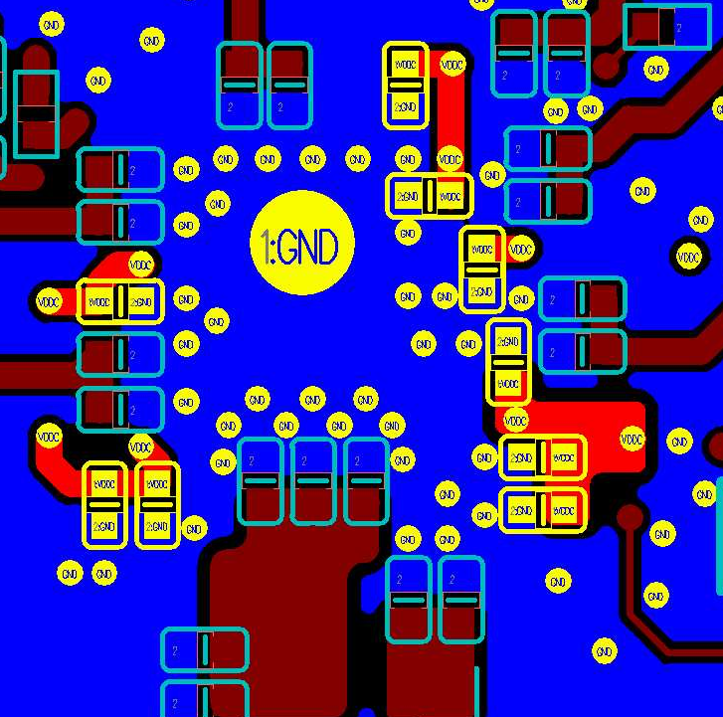
QFN – 4L/6L-PCB – VDDC – Rule 1
Power | Layer | SOC VIA count | DeCap | Layout rule
VDDC | Top/Bottom | 10 | (1) 0402 0.1uF: C1/C2/C6/C8/ (2) 0402 1uF: C3/C4/C9 (3) 0402 4.7uF: C5/C7 | VDDC VIA rule 1) 每根VDDC pin 需连接两颗VIA 2) 确认每颗Cap旁至少1颗VDDC VIA (2) GND VIA rule 确认每颗Cap旁至少1颗GND VIA
VDDC@Top
VDDC@Bottom
C7
C8
SOC
C9
C6
C1
C2
C5
C4
C3

Slide 48
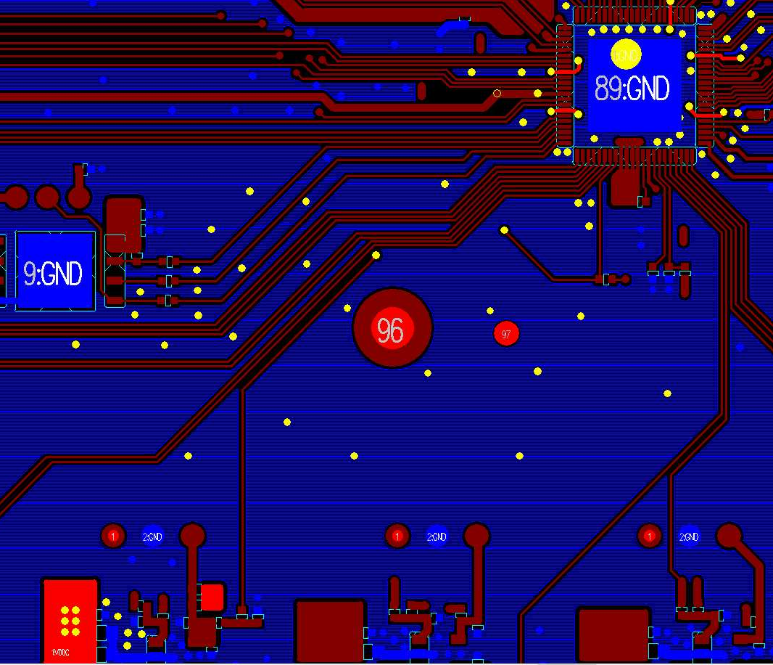
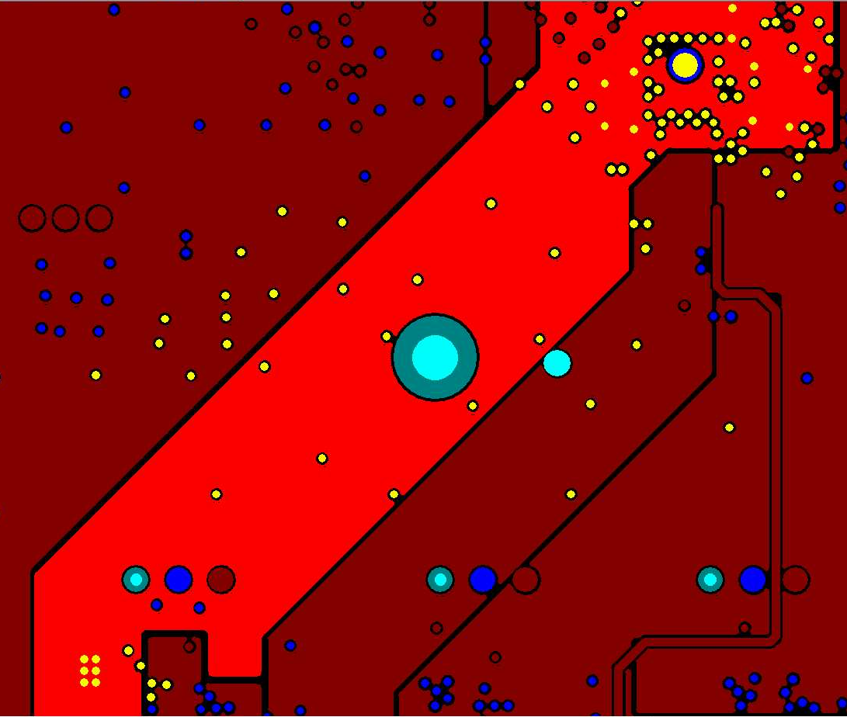
QFN – 4L/6L-PCB – VDDC – Rule 2
Power | Layer | Layout rule
VDDC | VDDC main routing, 4L-PCB: DDR3_1.5V@L3 6L-PCB: DDR3_1.5V@L4 | DDR3_1.5V 内层绕线: (1) 确认SOC处10颗VIA, PMIC处6颗VIA (2) SOC区域扣除破孔有效宽度: W1>=4mm (SOC QFN正下方), W2>=1.5mm (进入SOC 区域) (3) PMIC区域扣除破孔有效宽度: W3>=1.5mm (4) Main route 扣除破孔有效宽度 : W4>=1.5mm
4L-PCB: VDDC@L3
6L-PCB: VDDC@L4
VDDC@Top
SOC
W1
W2
SOC处10颗VIA
SOC区域
W4
PMIC区域
PMIC
W3
PMIC处6颗VIA

Slide 49
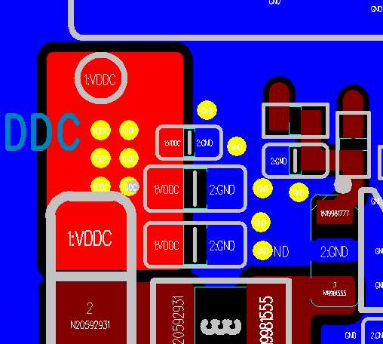
QFN – 4L/6L-PCB – VDDC – Rule 3
Power | PMIC 分支点 VIA 数量
VDDC | (1) VDDC: VIA 数量>=6 (2) GND: VIA 数量>=5
VDDC@Top
PMIC routing area
PMIC 分支点 VIA 数量
VDDC:
VIA 数量6
GND:
VIA 数量6
PMIC

Slide 50
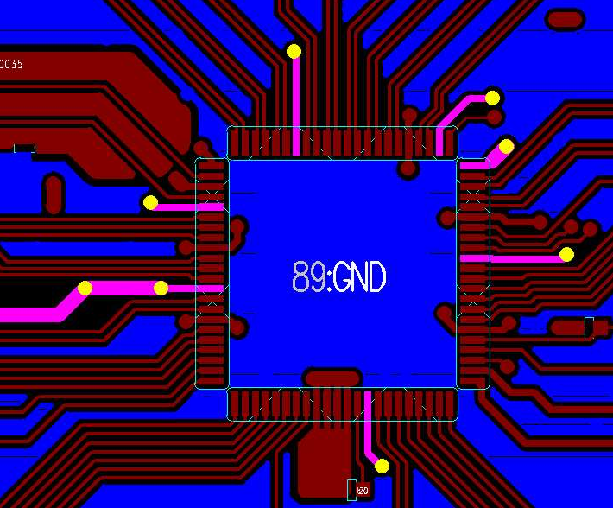
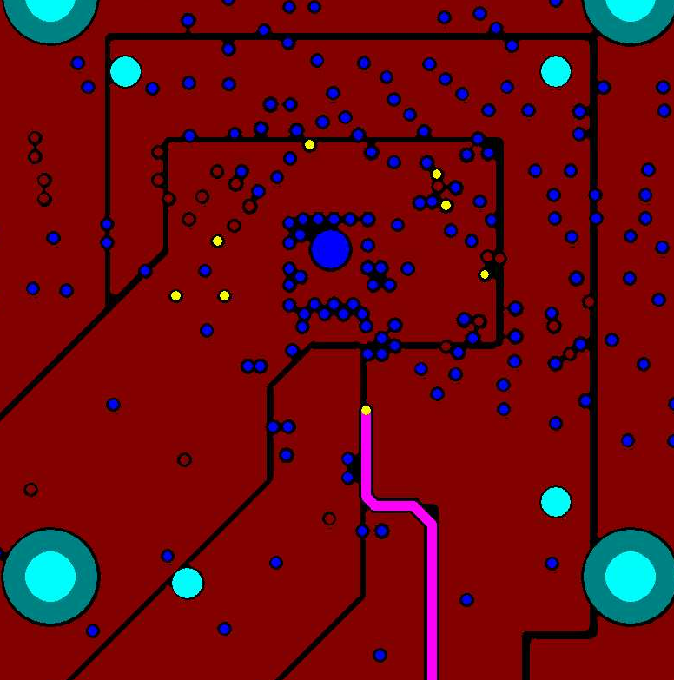
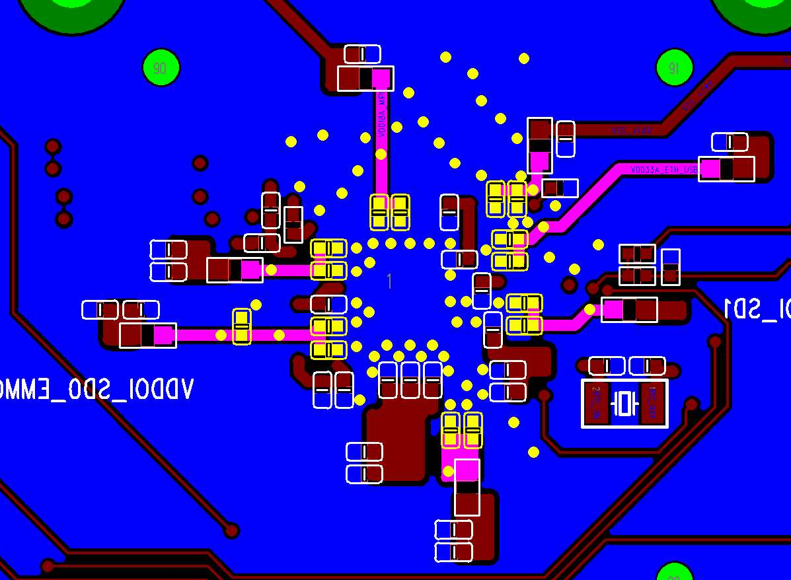
QFN – 4L/6L-PCB – Analog IO Power – Rule 1
Power | Layer | Layout rule
VDD18A_AUD/VDD_18A_MIPI VDD18A_USB_PLL_ETH VDD33A_EPH_USB VDDIO_RTC VDDIO_SD0_A/VDDIO_SD1 | 4L-PCB: Top/Bottom/L3 6L-PCB: Top/Bottom/L4 | @Top: (1) Break out (fan-out):线宽 W1>=0.25mm (2) Main route:线宽 W2>=0.5mm @内层: 所有线宽 W3>=0.5mm @Bottom:所有线宽 W4>=0.5mm
Analog IO power@Top
Analog IO power@内层
Analog IO power@Bottom
SOC
SOC
W4
W1
W1
W3
W2

Slide 51
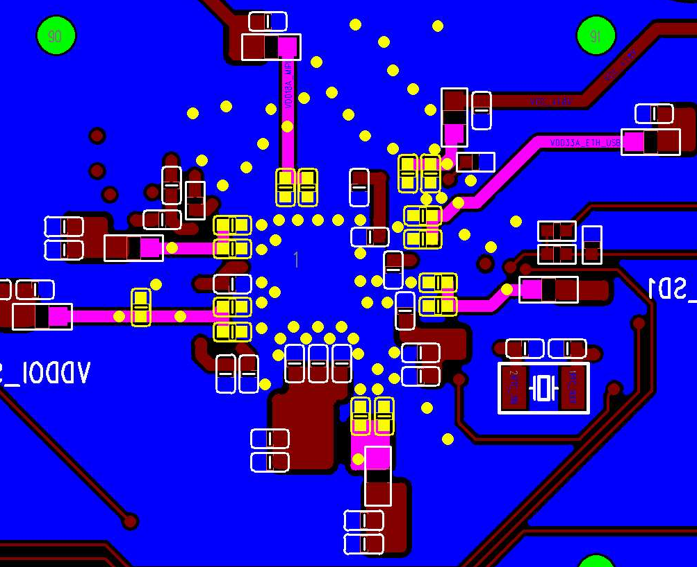
QFN – 4L/6L-PCB – Analog IO Power – Rule 2
Power | Layer | Layout rule
VDD18A_AUD/VDD_18A_MIPI VDD18A_USB_PLL_ETH VDD33A_EPH_USB VDDIO_RTC VDDIO_SD0_A/VDDIO_SD1 | Top/Bottom | (1) Analog IO power VIA rule 确认每颗Cap旁至少1颗analog IO power VIA (2) GND VIA rule 确认每颗Cap旁至少1颗GND VIA
Analog IO power@Top
Analog IO power@Bottom
SOC

Slide 52
模拟/数字电源绕线
BGA PKG: SG2000
4-layer/6-layer PCB

Slide 53
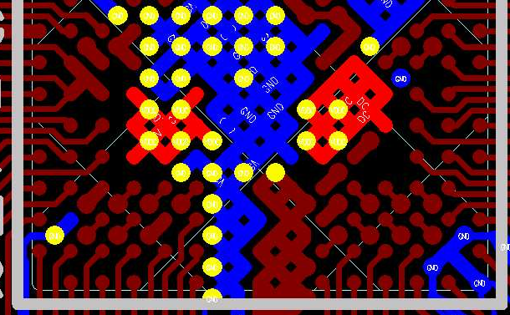
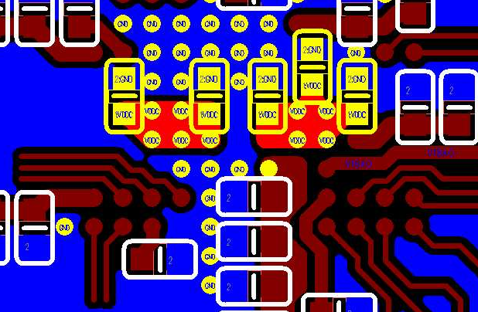
BGA – 4L/6L-PCB – VDDC – Rule 1
Power | Layer | SOC VIA count | DeCap | Layout rule
VDDC | Top/Bottom | 9 | (1) 0402 0.1uF: C1 (2) 0402 1uF: C3/C4/C5 (3) 0402 4.7uF: C2 | VDDC VIA rule 确认VDDC via紧连CAP (2) GND VIA rule 确认GND via紧连CAP
VDDC@Top
VDDC@Bottom
C4
SOC
C1
C2
C3
C5

Slide 54


BGA – 4L/6L-PCB – VDDC – Rule 2
Power | Layer | Layout rule
VDDC | VDDC main routing, 4L-PCB: DDR3_1.5V@L3 6L-PCB: DDR3_1.5V@L4 | DDR3_1.5V 内层绕线; (1) 确认SOC处9颗VIA, PMIC处6颗VIA (2) SOC区域,扣除破孔有效宽度: W1>=1mm (SOC ball 正下方), W2>=1.5mm (进入SOC 区域) (3) PMIC区域, 扣除破孔有效宽度: W3>=1.5mm (4) Main route, , 扣除破孔有效宽度: W4>=1.5mm
4L-PCB: DDR3_1.5V@L3
6L-PCB: DDR3_1.5V@L4
DDR3_1.5V@Top
SOC
SOC区域
W1
W2
SOC处9颗VIA
W4
PMIC区域
W3
PMIC
PMIC处6颗VIA

Slide 55


BGA – 4L/6L-PCB – VDDC – Rule 3
Power | PMIC 分支点 VIA 数量
VDDC | (1) VDDC: VIA 数量>=6 (2) GND: VIA 数量>=5
DDR3_1.5V@Top
PMIC routing area
PMIC 分支点 VIA 数量
VDDC:
VIA 数量6
GND:
VIA 数量5
PMIC

Slide 56



BGA – 4L/6L-PCB – Analog IO Power – Rule 1
Power | Layer | Layout rule
VDDIO_18A/VDDIO18_1 VDD18A_AUD/VDD18A_ETH/VDD_18A_MIPI VDD18A_PLL_N/VDD18A_USB VDD33A_EPHY/VDD33A_ETH VDDIO_EMMC/VDDIO_RTC/VDDIO_VIVO VDDIO_SD0/VDDIO_SD0_A/VDDIO_SD1 VDD09A_EPHY/VDD09A_MIPI VIN3V | 4L-PCB: Top/Bottom/L3 6L-PCB: Top/Bottom/L4 | @Top: 线宽 W1>=0.3mm (ball与VIA最短距离连线) @内层 : (1) SOC ball 区域: 线宽 W2>=0.3mm (2) SOC ball 以外区域: 线宽 W3>0.5mm @Bottom: (1) SOC ball 区域: 线宽 W4>=0.3mm (2) SOC ball 以外区域: 线宽 W5>0.5mm
Analog IO power@Top
Analog IO power@内层
Analog IO power@Bottom
SOC
SOC
SOC
W1
W3
W2
SOC bal区域
W5
SOC bal区域
SOC ball 以外区域
W4
SOC ball 以外区域

Slide 57


BGA – 4L/6L-PCB – Analog IO Power – Rule 2
Power | Layer | Layout rule
VDDIO_18A/VDDIO18_1 VDD18A_AUD/VDD18A_ETH/VDD_18A_MIPI VDD18A_PLL_N/VDD18A_USB VDD33A_EPHY/VDD33A_ETH VDDIO_EMMC/VDDIO_RTC/VDDIO_VIVO VDDIO_SD0/VDDIO_SD0_A/VDDIO_SD1 VDD09A_EPHY/VDD09A_MIPI VIN3V | Top/Bottom | (1) Analog IO power VIA rule 确认每颗Cap旁至少1颗analog IO power via (2) GND VIA rule 确认每颗Cap旁至少1颗GND via
Analog IO power@Top
Analog IO power@Bottom
SOC

Slide 58
Appendix

Slide 59
MIPI/EPHY/USB/Antenna 阻抗控制
4-layer PCB

Slide 60
MIPI/EPHY/USB 阻抗控制 –表层走线 Option1
Layer | Target Z (ohm) | W (mils) | S (mils) | D (mils) | Estimated Z (ohm)
Top/Bottom | 100 | 5 | 5 | 6 | 97.99
 | 90 | 5 | 4 | 6 | 92.48
MIPI/USB differential signals are required impedance control - Target impedance: (1) MIPI- CSI/DSI: 100ohm (2)USB: 90ohm
Differential signals shielding rule:
- pair to pair GND shielding
D
W
S
W
D
G
P
N
G
pp
GND

Slide 61


MIPI/EPHY/USB 阻抗控制 –表层走线 Option1
Target Z (ohm) | W (mils) | S (mils) | D (mils) | Estimated Z (ohm)
100 +/- 5% | 5 | 5 | 6 | 97.99
Target Z | W (mils) | S (mils) | D (mils) | Estimated Z (ohm)
90 +/- 5% | 5 | 4 | 6 | 92.48

Slide 62
MIPI 阻抗控制 – 表层走线 Option2
Layer | Target Z (ohm) | W (mils) | S (mils) | Ds (mils) | Dg (mils) | Estimated Z (ohm) | Rule
Top/Bottom | 100 | 5 | 5 | 12 | 12 | 99.96 | Ds=3W, Dg=3W
G
P
N
P
N
G
pp
Dg
W
S
W
Ds
W
S
W
Dg
GND

Slide 63



MIPI 阻抗控制 – 表层走线 Option2
Target Z (ohm) | W (mils) | S (mils) | Ds (mils) | Dg (mils) | Estimated Z (ohm)
100 +/- 5% | 5 | 5 | 12 | 12 | 99.96
 | 4 | 4 | 12 | 12 | 101.21

Slide 64
MIPI 阻抗控制 – 内层走线
Layer | Target Z (ohm) | W (mils) | S (mils) | Ds (mils) | Dg (mils) | Estimated Z (ohm)
L2/L3 | 100 | 5 | 10 | 12 | 12 | 98.93
GND
pp
G
P
N
P
N
G
Dg
W
S
W
Ds
W
S
W
Dg
Core
GND

Slide 65



MIPI 阻抗控制 – 内层走线
Target Z (ohm) | W (mils) | S (mils) | Ds (mils) | Dg (mils) | Estimated Z (ohm)
100 +/- 5% | 5 | 10 | 12 | 12 | 98.93
 | 4 | 7 | 12 | 12 | 100.18

Slide 66
EPHY/USB 阻抗控制 – 内层走线
Layer | Target Z (ohm) | W (mils) | S (mils) | D (mils) | Estimated Z (ohm)
L2/L3 | 100 | 5 | 10 | 12 | 98.92
 | 90 | 5 | 7 | 6 | 90.33
GND
D
W
S
W
D
pp
G
P
N
G
Core
GND

Slide 67




EPHY/USB 阻抗控制 – 内层走线
Target Z (ohm) | W (mils) | S (mils) | D (mils) | Estimated Z (ohm)
100 +/- 5% | 5 | 10 | 12 | 98.92
 | 4 | 7 | 8 | 99.11
Target Z (ohm) | W (mils) | S (mils) | D (mils) | Estimated Z (ohm)
90 +/- 5% | 5 | 7 | 6 | 90.33
 | 4 | 5 | 6 | 90.34

Slide 68
Antenna 50ohm 阻抗控制
Layer | Target Z (ohm) | W (mils) | D1 (mils) | D2(mils) | Estimated Z (ohm) | Note
Top | 50 | 30 | 6 | 12 | 50.93 | Ref layer L4
Layer - Top
D1
W
D1
L1
G
Sig
G
pp
L2
GND
D2
D2
GND
Core
L3
GND
PWR
PWR
pp
L4
GND

Slide 69

Antenna 50ohm 阻抗控制
Target Z (ohm) | W (mils) | D1 (mils) | D2(mils) | Estimated Z (ohm)
50 +/- 5% | 30 | 6 | 12 | 50.93
D1
W
D1
L1
G
Sig
G
pp
L2
GND
D2
D2
GND
Core
L3
GND
PWR
PWR
pp
L4
GND

Slide 70
MIPI/EPHY/USB/Antenna 阻抗控制
真6层, 6-layer PCB

Slide 71
MIPI/EPHY/USB 阻抗控制 –表层走线 Option1
Layer | Target Z (ohm) | W (mils) | S (mils) | D (mils) | Estimated Z (ohm)
Top/Bottom | 100 | 5 | 5 | 6 | 97.99
 | 90 | 5 | 4 | 6 | 92.48
MIPI/USB differential signals are required impedance control - Target impedance: (1) MIPI- CSI/DSI: 100ohm (2)USB: 90ohm
Differential signals shielding rule:
- pair to pair GND shielding
D
W
S
W
D
G
P
N
G
pp
GND

Slide 72
MIPI/EPHY/USB 阻抗控制 –表层走线 Option1
Target Z (ohm) | W (mils) | S (mils) | D (mils) | Estimated Z (ohm)
100 +/- 5% | 5 | 5 | 6 | 97.99
Target Z | W (mils) | S (mils) | D (mils) | Estimated Z (ohm)
90 +/- 5% | 5 | 4 | 6 | 92.48

Slide 73
MIPI 阻抗控制 – 表层走线 Option2
Layer | Target Z (ohm) | W (mils) | S (mils) | Ds (mils) | Dg (mils) | Estimated Z (ohm) | Rule
Top/Bottom | 100 | 5 | 5 | 12 | 12 | 99.96 | Ds=3W, Dg=3W
G
P
N
P
N
G
pp
Dg
W
S
W
Ds
W
S
W
Dg
GND

Slide 74
MIPI 阻抗控制 – 表层走线 Option2
Target Z (ohm) | W (mils) | S (mils) | Ds (mils) | Dg (mils) | Estimated Z (ohm)
100 +/- 5% | 5 | 5 | 12 | 12 | 99.96
 | 4 | 4 | 12 | 12 | 101.21

Slide 75
MIPI 阻抗控制 – 内层走线
Layer | Target Z (ohm) | W (mils) | S (mils) | Ds (mils) | Dg (mils) | Estimated Z (ohm)
L2/L3 | 100 | 5 | 10 | 12 | 12 | 98.44
GND
pp
G
P
N
P
N
G
Dg
W
S
W
Ds
W
S
W
Dg
Core
GND

Slide 76


MIPI 阻抗控制 – 内层走线
Target Z (ohm) | W (mils) | S (mils) | Ds (mils) | Dg (mils) | Estimated Z (ohm)
100 +/- 5% | 5 | 10 | 12 | 12 | 98.44
 | 4 | 7 | 12 | 12 | 99.92

Slide 77
EPHY/USB 阻抗控制 – 内层走线
Layer | Target Z (ohm) | W (mils) | S (mils) | D (mils) | Estimated Z (ohm)
L2/L3 | 100 | 5 | 10 | 12 | 98.44
 | 90 | 5 | 7 | 6 | 90.14
GND
D
W
S
W
D
pp
G
P
N
G
Core
GND

Slide 78




EPHY/USB 阻抗控制 – 内层走线
Target Z (ohm) | W (mils) | S (mils) | D (mils) | Estimated Z (ohm)
100 +/- 5% | 5 | 10 | 12 | 98.44
 | 4 | 7 | 8 | 98.92
Target Z (ohm) | W (mils) | S (mils) | D (mils) | Estimated Z (ohm)
90 +/- 5% | 5 | 7 | 6 | 90.14
 | 4 | 5 | 6 | 90.24

Slide 79
Antenna 50ohm 阻抗控制
Layer | Target Z (ohm) | W (mils) | D1 (mils) | D2(mils) | Estimated Z (ohm) | Note
Top | 50 | 30 | 6 | 12 | 50.55 | Ref layer L5
Layer - Top
D1
W
D1
L1
G
Sig
G
pp
D2
D2
L2
GND
GND
Core
L3
GND
GND
pp
PWR
PWR
L4
GND
Core
L5
GND

Slide 80

Antenna 50ohm 阻抗控制
Target Z (ohm) | W (mils) | D1 (mils) | D2(mils) | Estimated Z (ohm)
50 +/- 5% | 30 | 6 | 12 | 50.55
D1
W
D1
L1
G
Sig
G
pp
D2
D2
L2
GND
GND
Core
L3
GND
GND
pp
PWR
PWR
L4
GND
Core
L5
GND

